Slide 1
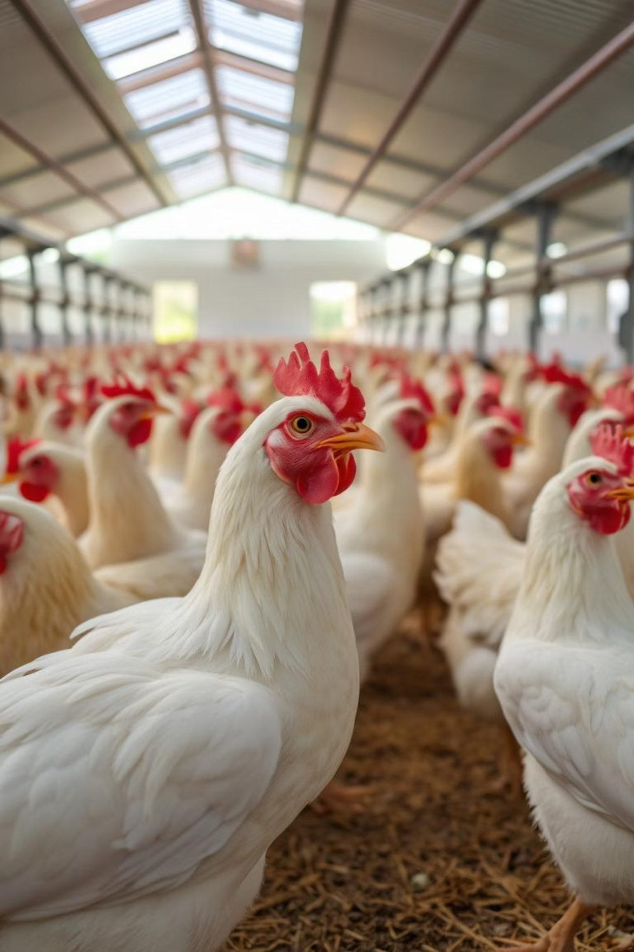
Transfer Learning –Based Classification of poultry Diseases for Enhanced Health Management
This poultry industry faces significant losses due to undetected or late-detected diseases. Manual diagnosis based on visual symptoms is prone to error and delay. This project aims to implement a transfer learning-based model that can analyze images of poultry (especially skin, feathers, and break) to classify diseases accurately and in real-time. By reducing dependency on veterinary intervention for initial diagnosis, the system can enhance poultry health management, minimize economic losses, and contribute to food security.
Team Id:LTVIP2025TMID20259
Team Leader: Akuri Afreen
Team Member: Aalla Uha Sri Priya
Team Member: A Srihari
Team Member: A Pravallika

Slide 2
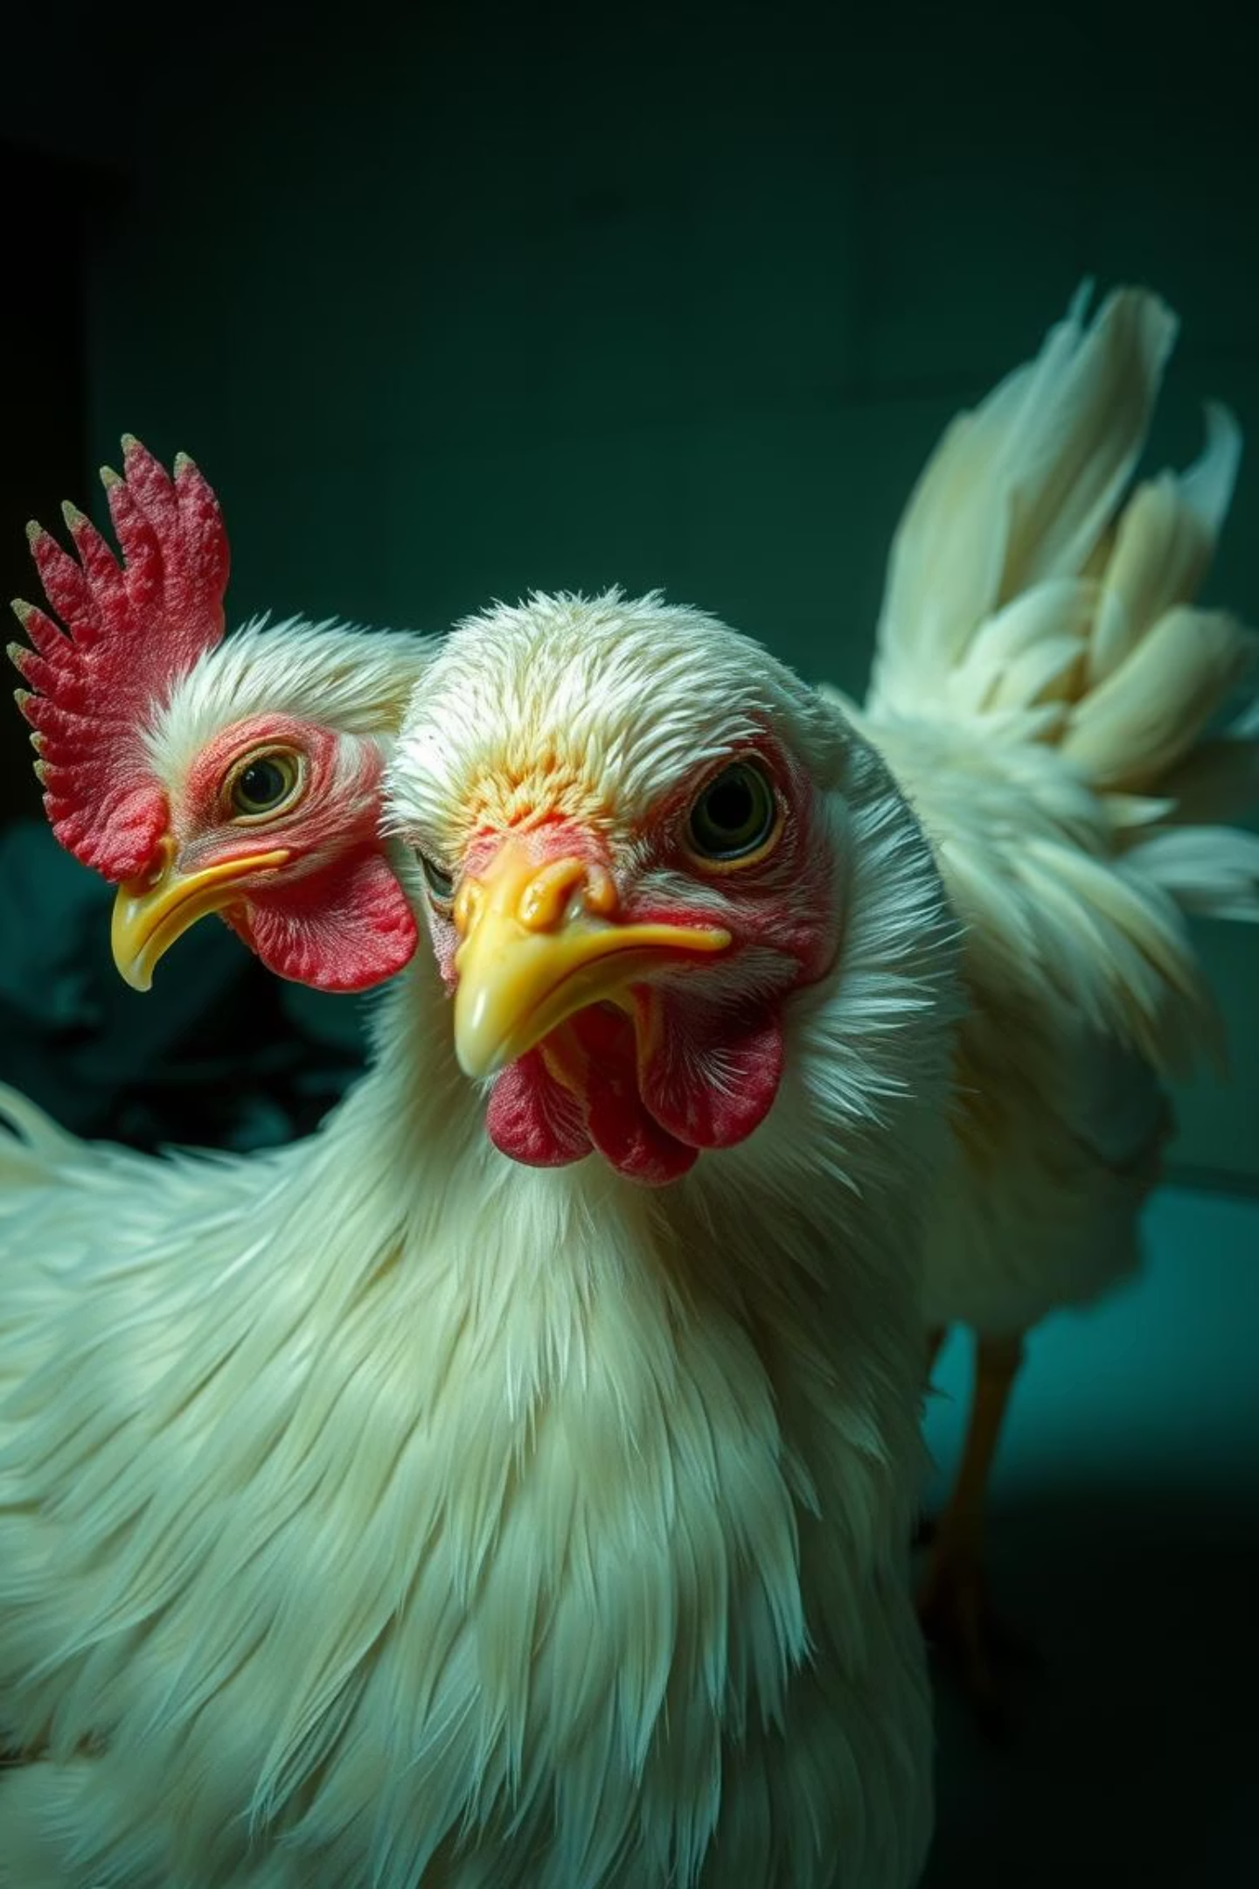
Understanding Poultry Disease Challenges
Poultry diseases pose a significant threat to global food security and economic stability in the agricultural sector. Rapid and accurate diagnosis is crucial for effective disease management, preventing widespread outbreaks and reducing antibiotic reliance. Traditional diagnostic methods can be time-consuming and resource-intensive.

Slide 3
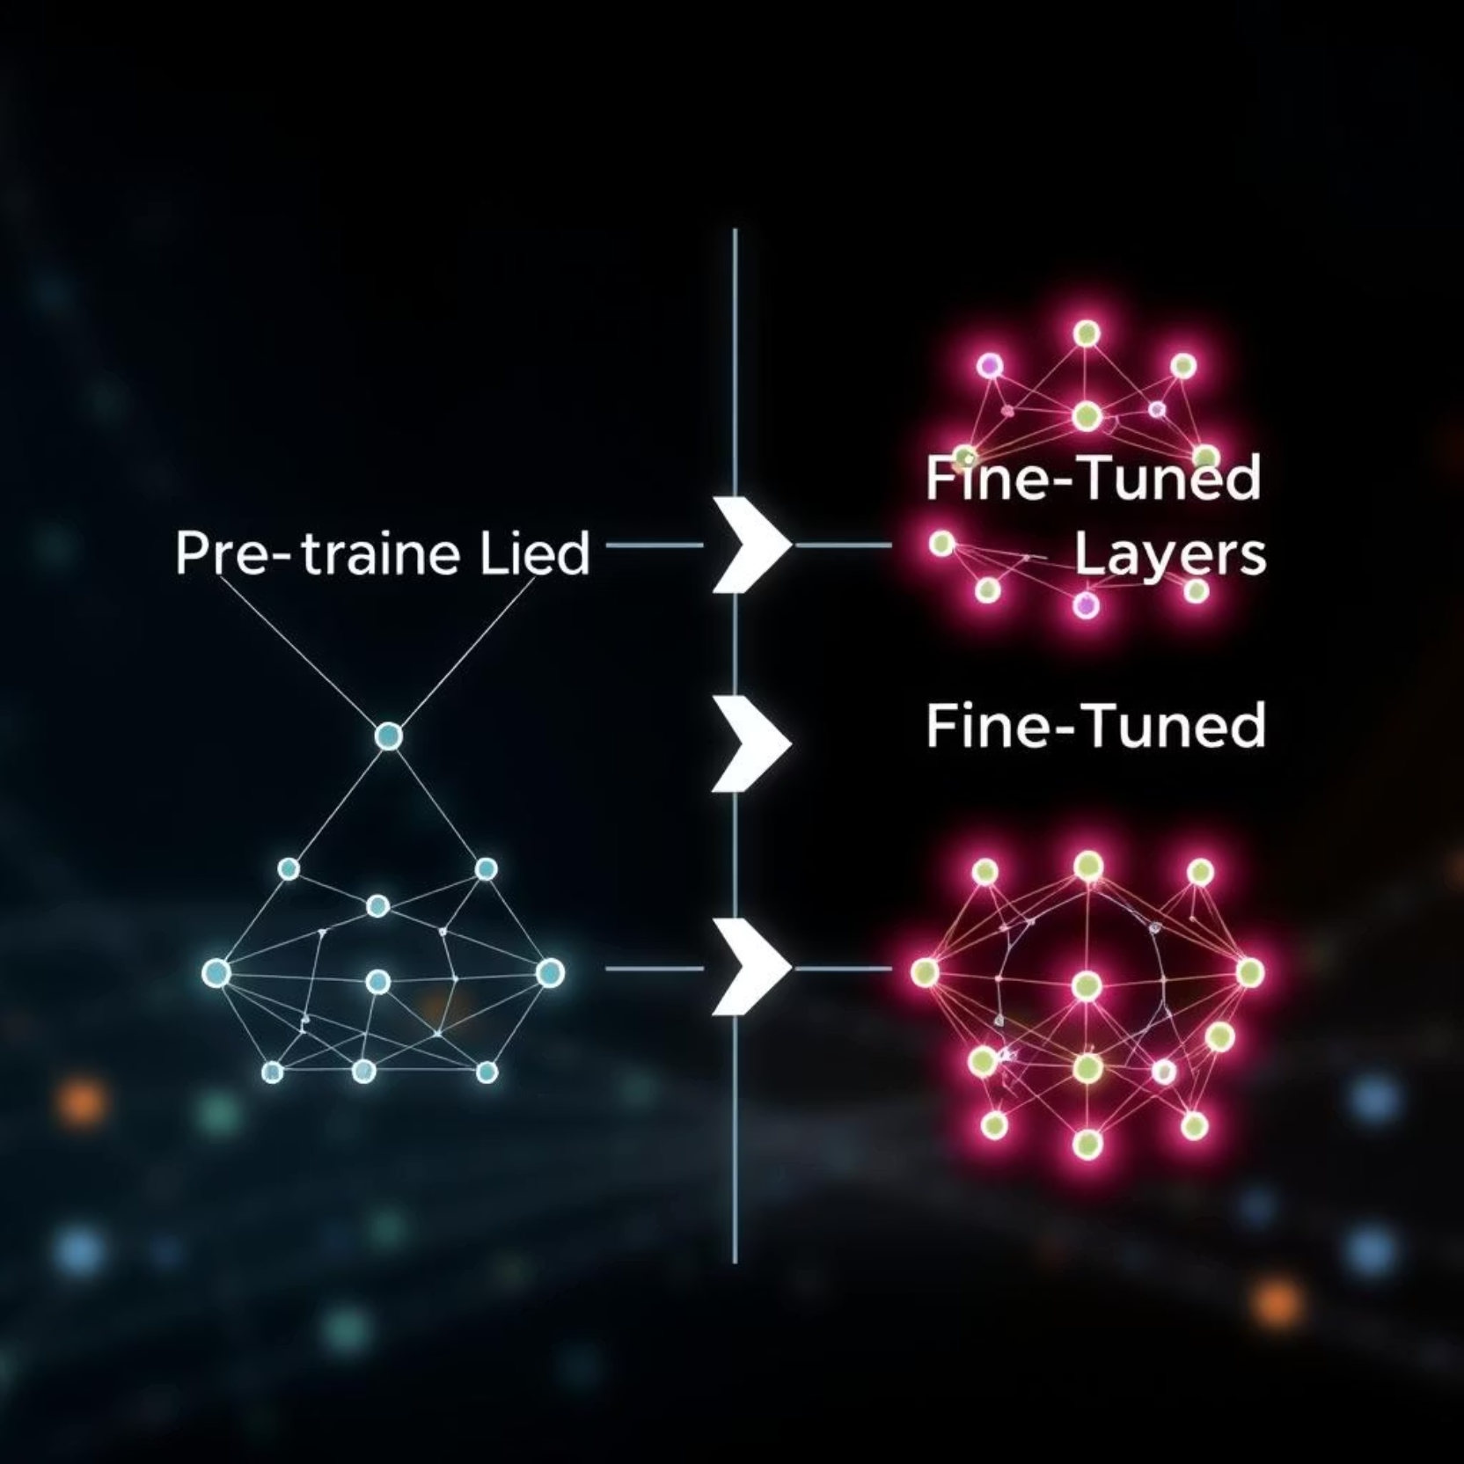
Introduction to Transfer Learning
Transfer learning is a machine learning technique where a model trained on one task is repurposed for a second, related task. In the context of image classification, this involves using pre-trained convolutional neural networks (CNNs) that have learned to recognize a wide range of features from large datasets like ImageNet.
This approach is especially useful in deep learning, where training models from the ground up can be resource-intensive. Transfer learning helps improve performance, reduce training time, and tackle problems where labeled data is limited. Common applications include image classification, natural language processing, and speech recognition.

Slide 4
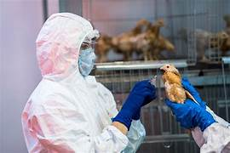



Advantages of Transfer Learning in Poultry Diagnostics
Reduced Data Dependency
Faster Training Times
Requires less labelled training data for the target task, which is beneficial in medical imaging where datasets can be scarce.
Fine-tuning pre-trained models is significantly faster than training a deep CNN from scratch, accelerating deployment.
Improved Performance
Leverages features learned from vast datasets, leading to higher accuracy and generalisation even with limited domain-specific data.

Slide 5
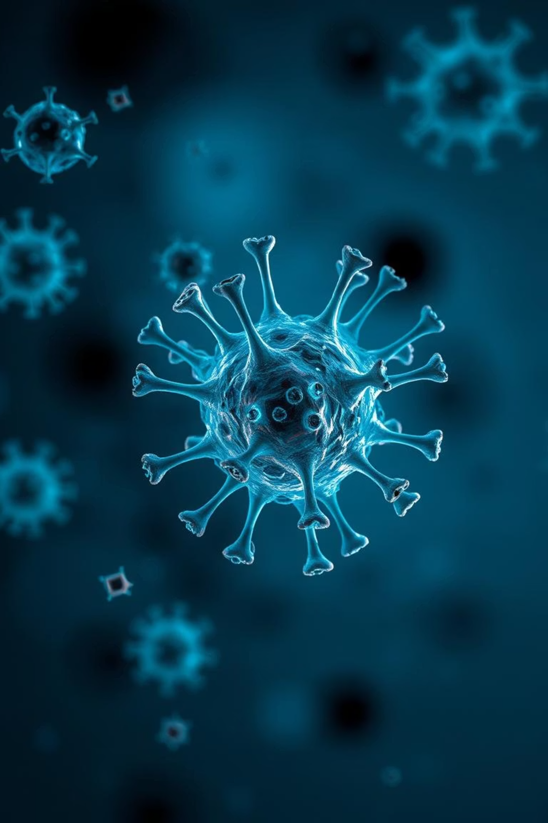
Methodology: Dataset and Pre-processing
Our study utilises a curated dataset of poultry disease images, including visual symptoms of common ailments like Newcastle Disease, Avian Influenza, and Fowl Pox. Images undergo pre-processing steps such as normalisation, resizing, and augmentation to enhance model robustness and prevent overfitting.
The dataset used for this project consists of labeled images collected from a reliable source, ensuring diversity across classes. Before training, pre-processing steps are applied to enhance model performance. These include resizing all images to a uniform size, normalizing pixel values to a standard range (typically 0 to 1), and augmenting the data through techniques like rotation, flipping, and zooming to improve generalization.

Slide 6
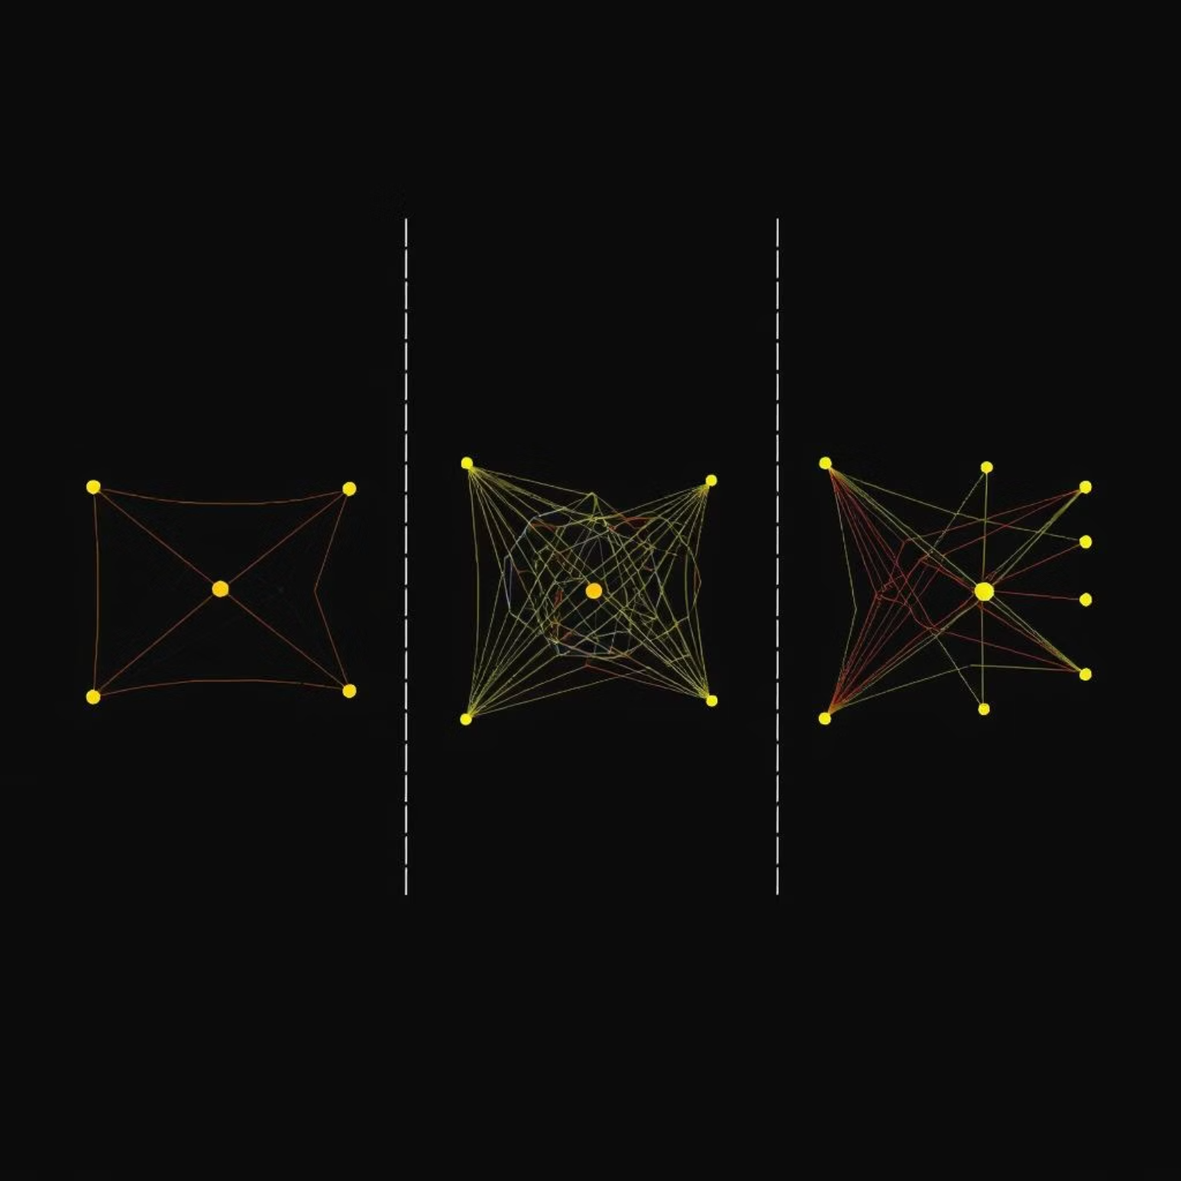
Model Selection and Fine-tuning Strategies
We experimented with several popular pre-trained CNN architectures, including ResNet, VGG, and InceptionV3. Various fine-tuning strategies were explored, such as freezing earlier layers and training only the final classification layers, or unfreezing a few top layers for more domain-specific feature extraction.
For this project, a pre-trained convolutional neural network (CNN) such as VGG16, ResNet50, or MobileNet was selected due to its proven performance on image classification tasks. The top (fully connected) layers were removed and replaced with custom layers suited to the target classes. Initially, the pre-trained layers were frozen to train only the new layers.

Slide 7
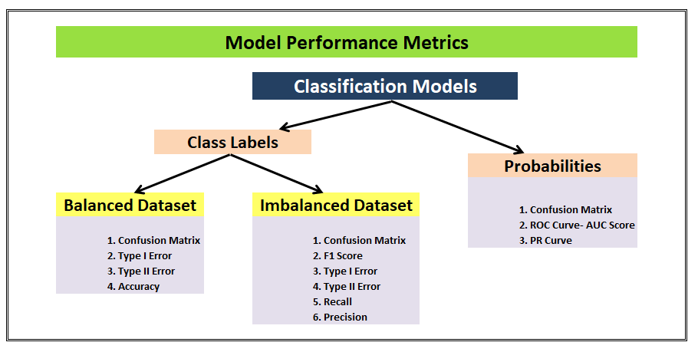

Slide 8

Impact and Future Directions
Early Detection and Prevention
Enables proactive intervention, minimising disease spread and reducing economic losses for poultry farmers.
Resource Optimisation
Reduces the need for extensive lab testing, making diagnostic processes more efficient and accessible, especially in rural areas.
Expansion to Other Species
The methodology can be adapted for disease classification in other livestock, broadening its application across agriculture.

Slide 9
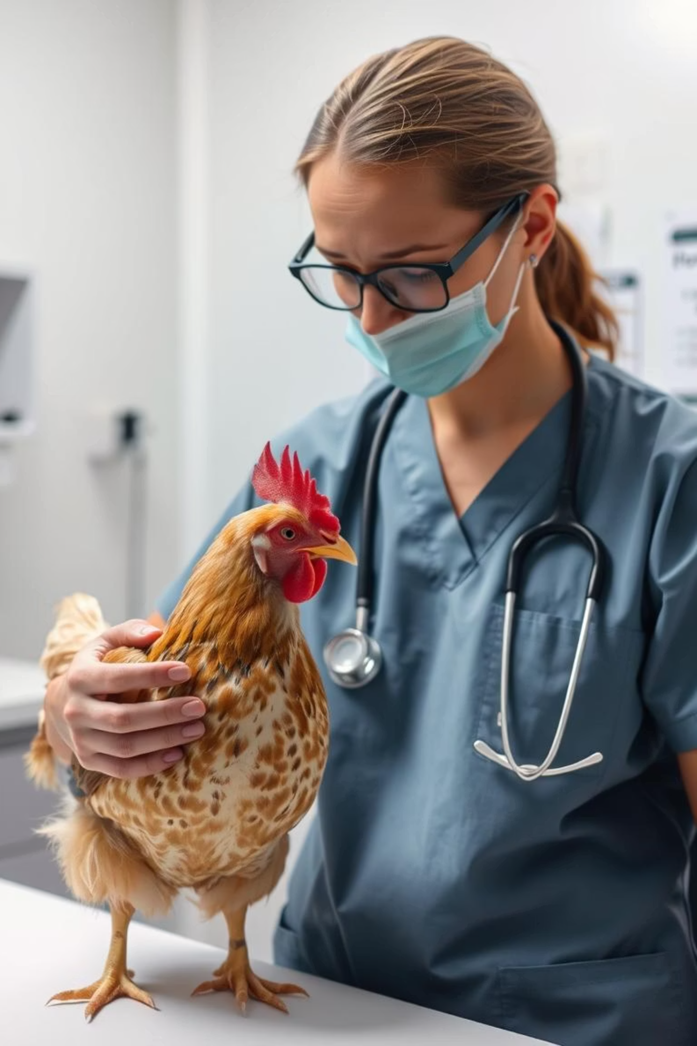
Challenges and Limitations
While promising, transfer learning in poultry diagnostics faces challenges such as the variability of disease symptoms, image quality inconsistencies, and the need for continuous model updates as new disease strains emerge. Ethical considerations regarding AI bias in diagnosis also warrant attention.

Slide 10

Key Takeaways and Next Steps
Validated Approach
Real-world Impact
Transfer learning provides a robust and efficient method for poultry disease classification.
Potential to significantly enhance poultry health management and sustainability.
Further Research
Future work includes integrating multi-modal data and developing explainable AI models for greater diagnostic transparency.

Slide 11
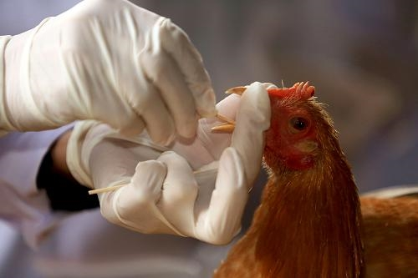
Conclusion:
Transfer learning has proven to be an effective approach for enhancing poultry disease classification. By leveraging pre-trained deep learning models such as ResNet or VGG, we significantly reduced training time while maintaining high accuracy, even with a limited dataset. The model effectively learned to identify subtle visual patterns associated with various poultry diseases, which can be challenging using traditional methods.
Fine-tuning selected layers allowed for better adaptation to the specific characteristics of poultry images. This approach not only improved classification performance but also demonstrated strong generalization on unseen data.

